Slide 1


Design and Deploy Scalable Cloud-Native Applications Using Docker
ResolveX — Smart Student Complaint Management System
A full-stack, containerized platform built with React, Node.js, Docker, and AWS EC2 — demonstrating modern cloud-native architecture and DevOps best practices.
Presented By: [Khushboo shukla]
Notes:
1

Slide 2


PROJECT OVERVIEW
What Is ResolveX?
ResolveX is a cloud-native, full-stack complaint management platform that enables students to register, track, and manage complaints online — while administrators monitor, prioritize, and resolve them through a centralized dashboard. Built with modern architecture and deployed via Docker containers on AWS EC2.
🎓 Student Portal
🔧 Admin Dashboard
Secure login, complaint submission, real-time status tracking, and full complaint history — all in one place.
Centralized management, analytics, user oversight, and resolution workflow controls for administrators.
☁️ Cloud Deployment
Containerized with Docker Compose and hosted on AWS EC2 for high availability and seamless scalability.
Notes:
2

Slide 3

PROBLEM & SOLUTION
The Problem — and How ResolveX Solves It
⚠️ Current Challenges
✅ The ResolveX Solution
  Delayed complaint resolution with no clear accountability
  Lack of transparency and no centralized tracking
  Poor communication between students and administrators
  Manual, error-prone administration processes
  Difficult deployment and limited scalability
  Online complaint registration with secure JWT authentication
  Real-time tracking and automated status updates
  Centralized admin dashboard with analytics
  Containerized deployment using Docker on AWS EC2
  Scalable, cloud-ready architecture for any institution
Submit Complaint
Admin Reviews
File issue through portal.
Manage case via dashboard.
Student Registers
Resolve & Update
Create account and log in.
Close case and notify student.
A streamlined, end-to-end workflow eliminates manual overhead and ensures full traceability from submission to resolution.
Notes:
3

Slide 4
TECHNOLOGY STACK
Technologies Powering ResolveX
Frontend
Backend
Database
Containerization
Cloud & DevOps
React.js, Vite, Tailwind CSS
Node.js, Express.js
MongoDB
Docker, Docker Compose
AWS EC2, Git, GitHub
Responsive UI, fast build tooling
RESTful API architecture
Flexible document storage
Multi-container orchestration
Version control, CI/CD-ready
Auth: JWT
Reverse Proxy: Nginx
React.js + Vite
Node.js + Express
Component-based UI with blazing-fast build tooling and hot module replacement for rapid development.
Lightweight RESTful API backend handling business logic, routing, and database interactions.
MongoDB
Docker Compose
Schema-flexible NoSQL database ideal for storing complaints, user profiles, and status records.
Orchestrates frontend, backend, database, and Nginx as isolated, interconnected containers.
Notes:
4

Slide 5
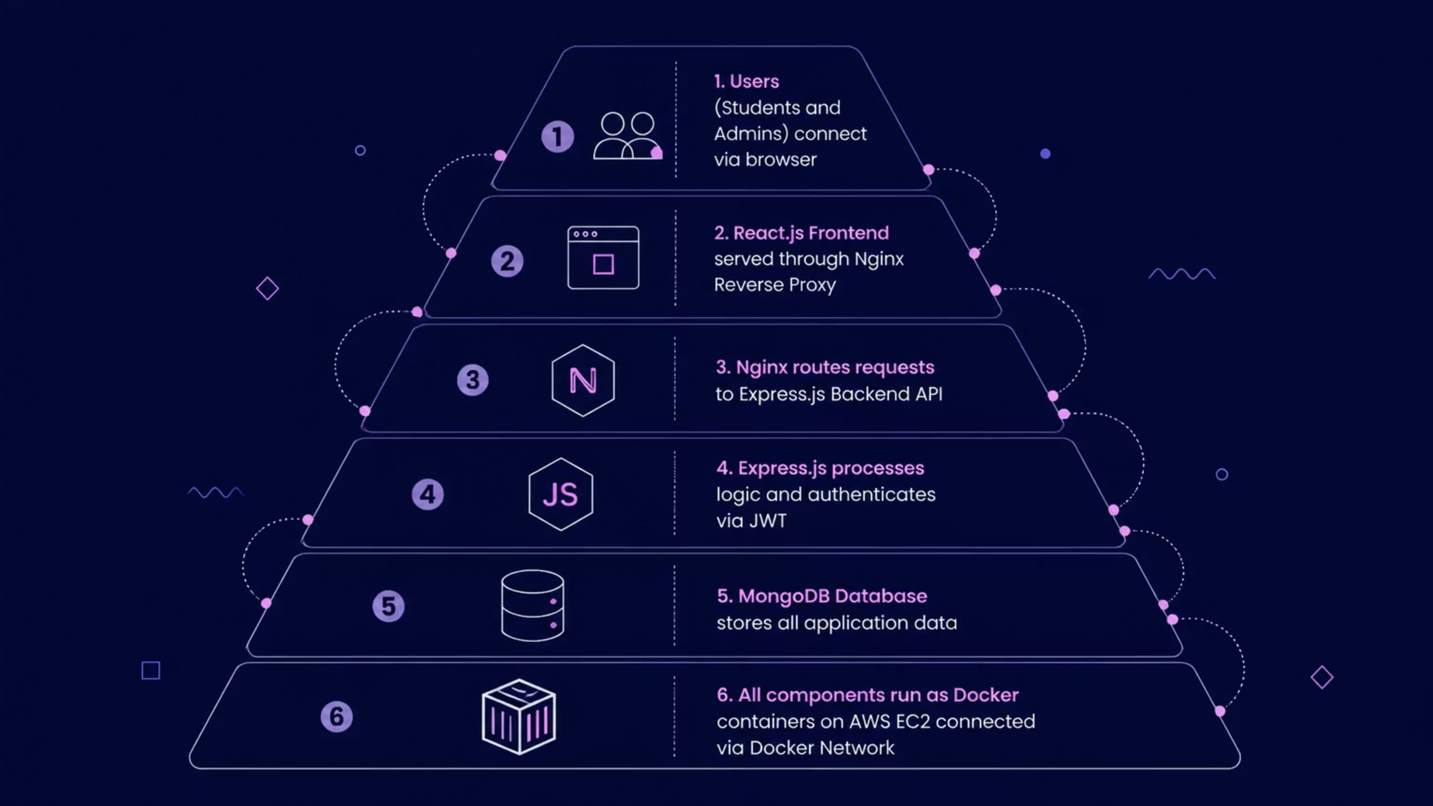
ARCHITECTURE & WORKFLOW
System Architecture & Development Workflow
All services run as isolated Docker containers on AWS EC2, communicating through a shared Docker network — ensuring clean separation of concerns and easy horizontal scaling.
Requirements
Frontend
Database
Testing
Deploy
Scope definition and feature planning
React + Vite + Tailwind CSS
MongoDB integration
Unit and integration tests
AWS EC2 live release
UI Design
Backend
Auth
Dockerize
Wireframes and component mockups
Node.js + Express API
JWT implementation
Containerize all services
Notes:
5

Slide 6

VERSION CONTROL & DOCKER
Git Workflow & Docker Implementation
Why Docker?
Git & GitHub Workflow
  Portability — Runs identically across any environment
  Consistency — Eliminates "works on my machine" issues
  Isolation — Each service runs in its own container
  Lightweight — Shares host OS kernel, minimal overhead
  Scalability — Spin up new instances in seconds
  Easy Deployment — One command to launch the full stack
  Initialize repository and stage changes
  Commit with descriptive messages
  Set main branch and push to remote
  Clone and collaborate via GitHub
git init
git add .
git commit -m "Initial Commit"
git branch -M main
git remote add origin
git push -u origin main
git clone
Docker Container
Running instance created from an image.
Docker Image
Docker Compose
Read-only blueprint with app and dependencies.
Orchestrates multiple containers as one stack.
Docker Compose ties all services together — frontend, backend, database, and Nginx — into a single, reproducible deployment unit.
Notes:
6

Slide 7
DOCKER COMMANDS
Essential Docker Compose Commands
These commands form the operational backbone of ResolveX deployment — from building images to managing live containers on AWS EC2.
Command
Purpose
docker compose build
Builds images for all services defined in docker-compose.yml
docker compose up -d
Starts all containers in detached (background) mode
docker ps
Lists all running containers and their status
docker images
Shows all locally stored Docker images
docker logs backend
Displays live log output from the backend container
docker compose down
Stops and removes all containers, networks, and volumes
docker compose restart
Restarts all running service containers
docker compose build --no-cache
Rebuilds images without using cached layers — ensures fresh builds
Notes:
7

Slide 8
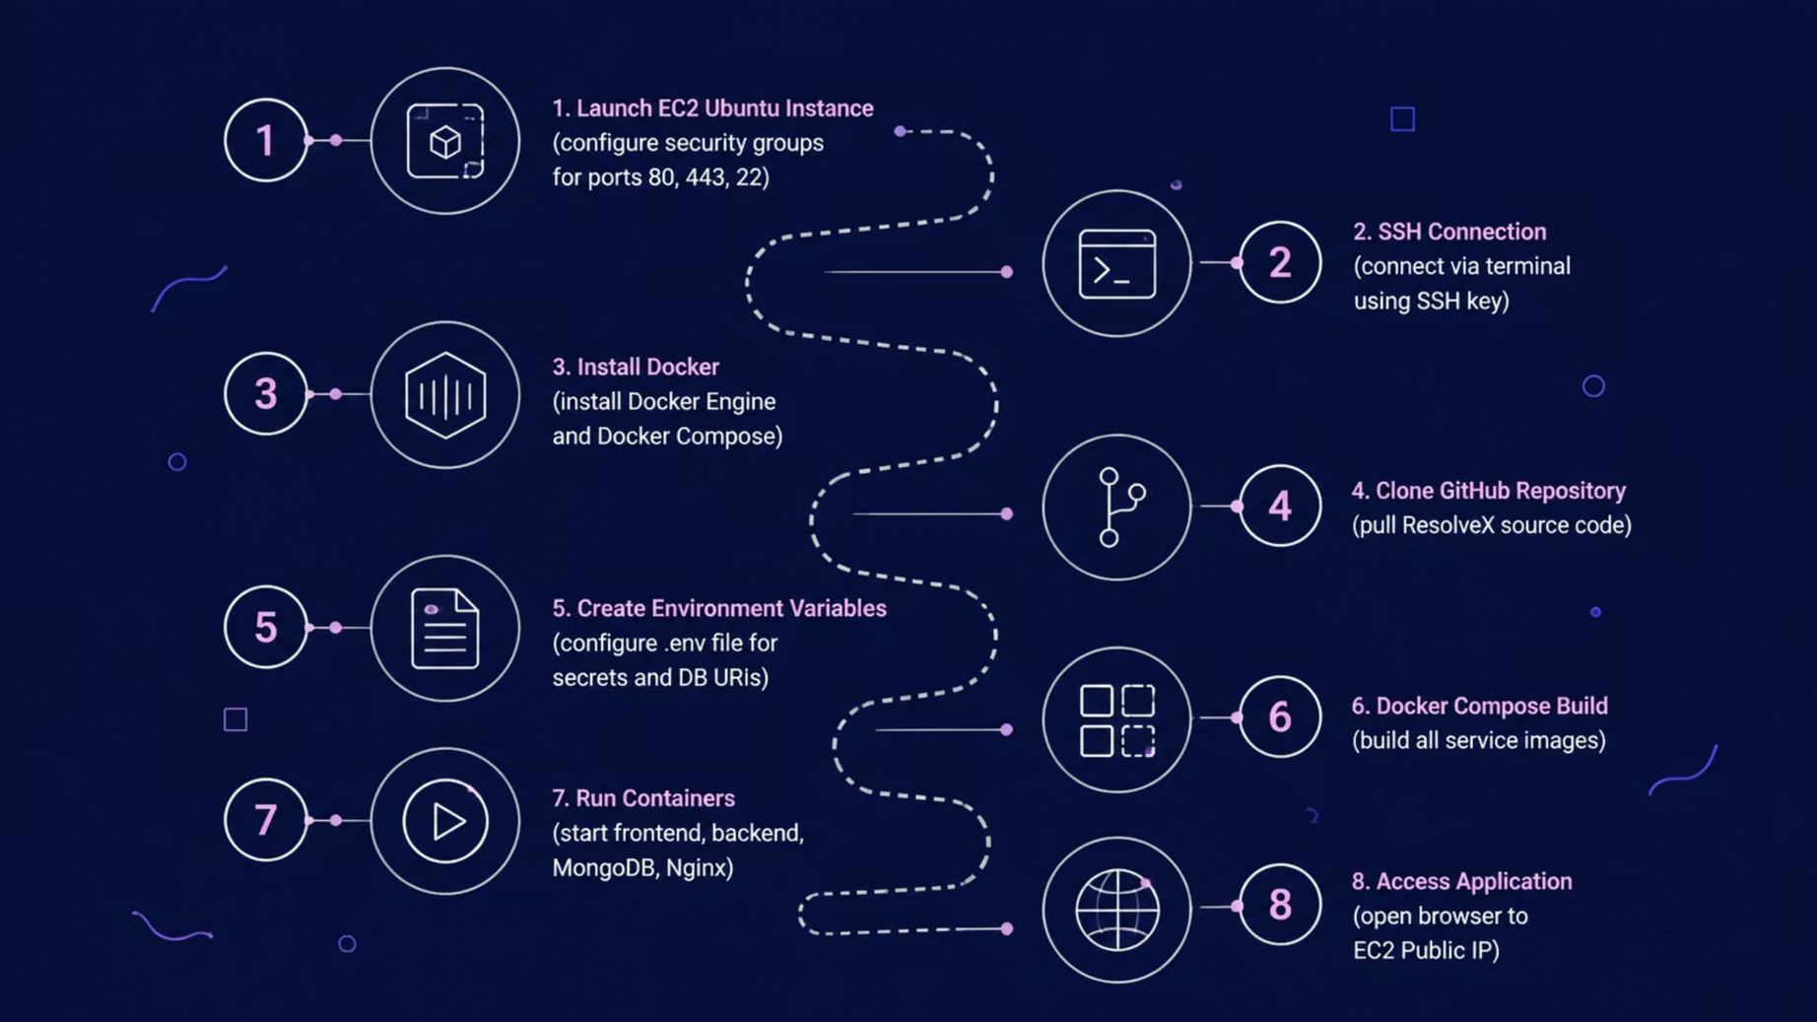
CLOUD DEPLOYMENT
Deploying ResolveX on AWS EC2
Each step ensures a reproducible, production-ready deployment. Docker eliminates environment inconsistencies, while AWS EC2 provides the scalable infrastructure to serve users globally with high availability.
All containers are connected via a Docker bridge network, allowing the backend to communicate securely with MongoDB while Nginx proxies external traffic to the React frontend.
Notes:
8

Slide 9
FEATURES & CHALLENGES
Platform Features & Lessons Learned
🎓 Student Module
⚠️ Challenges Encountered
  Secure registration and login with JWT
  Submit and track complaints in real time
  View full complaint history and status updates
  Missing Docker dependencies during container build
  Missing .env configuration causing connection failures
  Import path issues between frontend and backend
  Nginx port conflicts on the host machine
  Backend container restart loops and health check failures
🔧 Admin Module
  Centralized dashboard with complaint analytics
  Manage users and update complaint status
  Generate reports and monitor system health
✅ Solutions Applied
  Added missing packages to Dockerfiles explicitly
  Configured and validated all environment variables
  Fixed import paths and rebuilt affected images
  Resolved port conflicts by remapping host ports
  Verified container health with docker logs and docker inspect
Notes:
9

Slide 10
FUTURE SCOPE & CONCLUSION
What's Next — and Key Takeaways
🚀 Kubernetes
⚙️ CI/CD Pipeline
Automated scaling, self-healing, and rolling deployments for production-grade orchestration.
Jenkins and GitHub Actions for automated testing, building, and deployment on every commit.
📊 Monitoring
🤖 AI Classification
Prometheus and Grafana for real-time metrics, alerting, and system observability.
Machine learning to auto-categorize complaints and prioritize urgent issues intelligently.
ResolveX successfully demonstrates how a full-stack application can be transformed into a scalable, cloud-native solution using Docker containers and AWS EC2 — following DevOps best practices. The project highlights practical implementation of containerization, cloud deployment, version control, and scalable architecture suitable for enterprise environments.
4
9
Docker Containers
Technologies
Frontend, Backend, MongoDB, Nginx
Full modern cloud-native stack
1
100%
Cloud Platform
Containerized
AWS EC2 production deployment
Fully reproducible deployment
Notes:
10

